Slide 1

E-Buy Online Shopping Sprint-0
Team 2
Shirish Srinivasa
Kavya Raviprakash
Luke Henkenius
Akhila Pillalamarri

Slide 2
Team Members and Roles
Kavya Raviprakash – Project Manager / Developer
Shirish Srinivasa – Developer / Tester
Luke Henkenius – Developer / Tester
Akhila Pillalamarri - Scrum master / Developer

Slide 3
Index
Business use description of the web application.
Use Case Diagram
Data Model
Data Flow Diagram
Class Diagram
Mockups
APIs
Release plan and Stand-up notes Link
GitHub and Trello links

Slide 4
Business use description of the web application
Ecommerce or electronic commerce refers to a business model that involves sales transactions being done on the web. Virtually every online shopping website - big or small - follows this structure. Any site where you can obtain items for sale over the internet is considered an ecommerce website.
The purpose for designing this ecommerce (shopping-cart) application is because most of the people nowadays prefer shopping online rather than spending a lot of time at physical markets. It basically saves the shoppers time, and they can easily browse through hundreds of products from the place of their convenience.
Through the use of an ecommerce application, a retailer can sell his products to customers who might be living at distant places and a customer can easily browse through products, can also compare their prices and can buy the products that would suit their need.
This web application will be built using the python and Django Framework integrated with various APIs to improve the web application’s functionality.

Slide 5
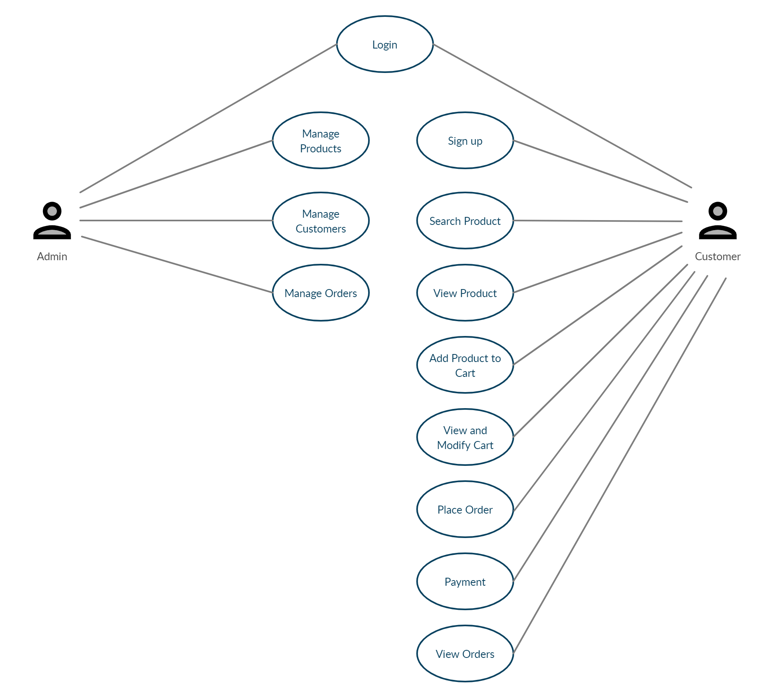
Use Case Diagram

Slide 6
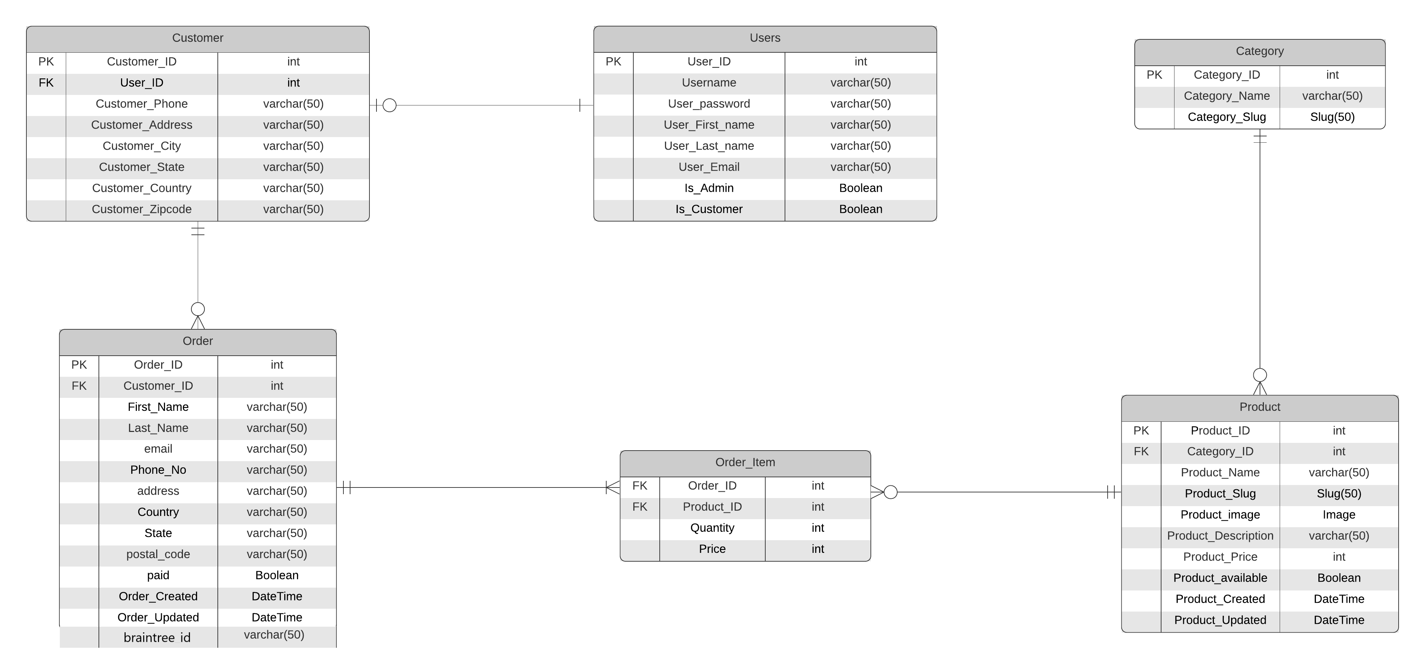
Data Model

Slide 7
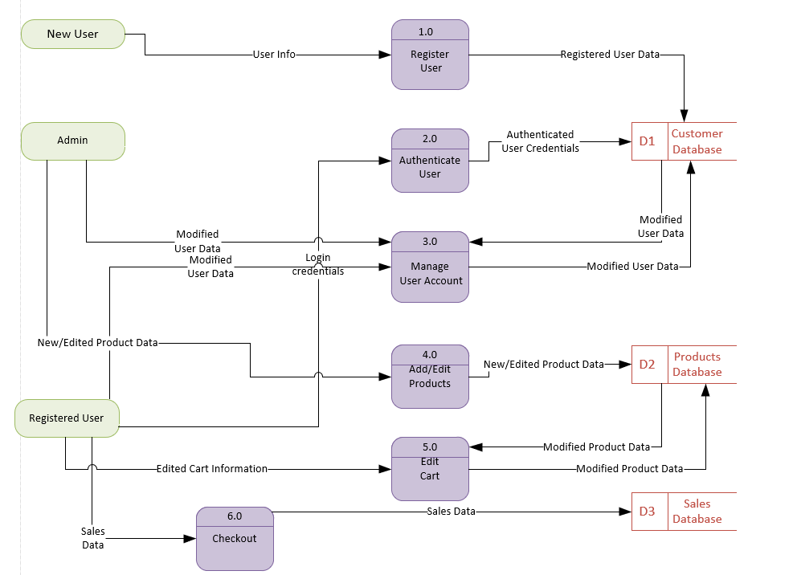
Data Flow Diagram

Slide 8
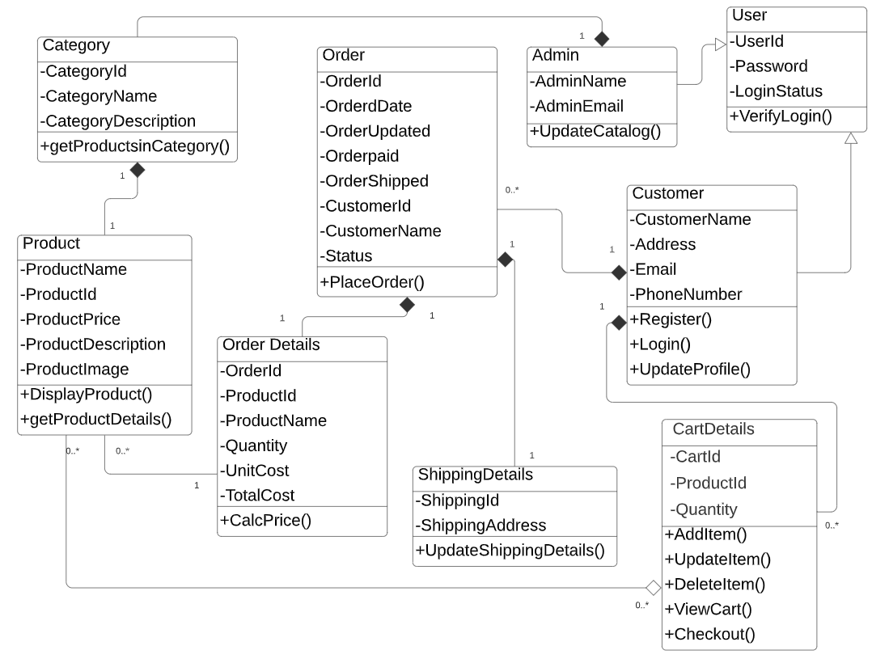
Class Diagram

Slide 9
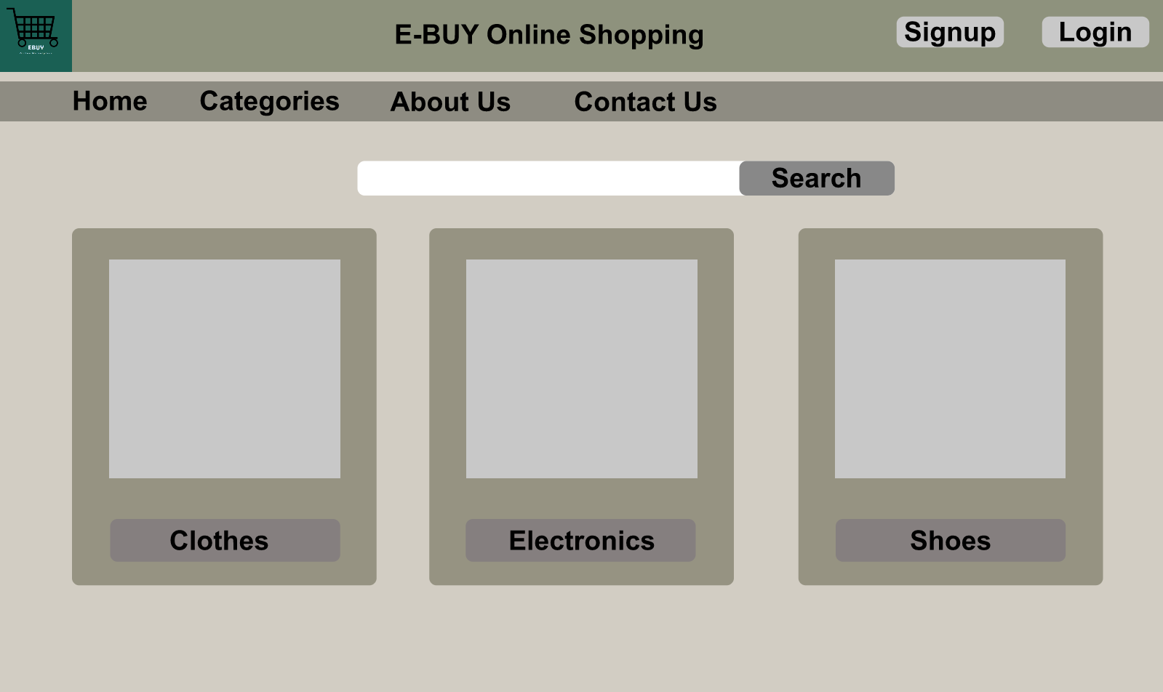
Mockups- Home Page

Slide 10
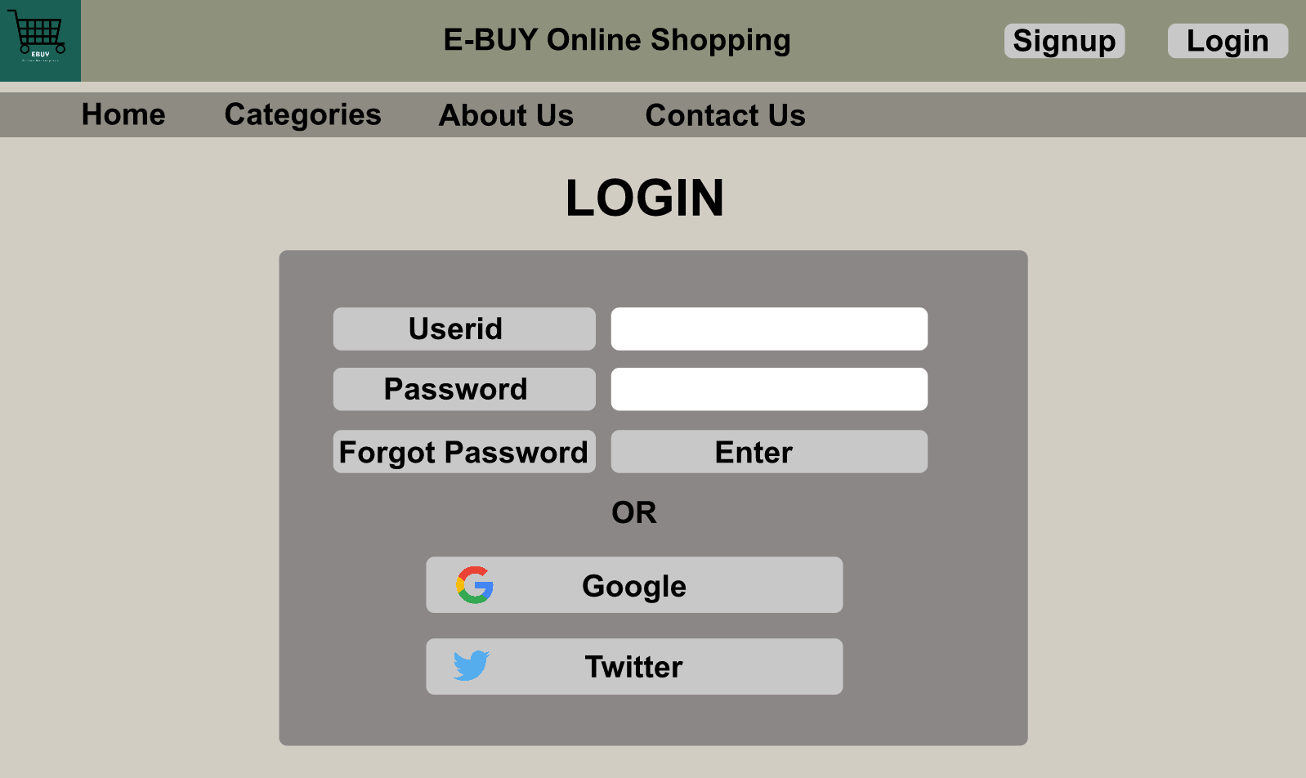
Login Page

Slide 11
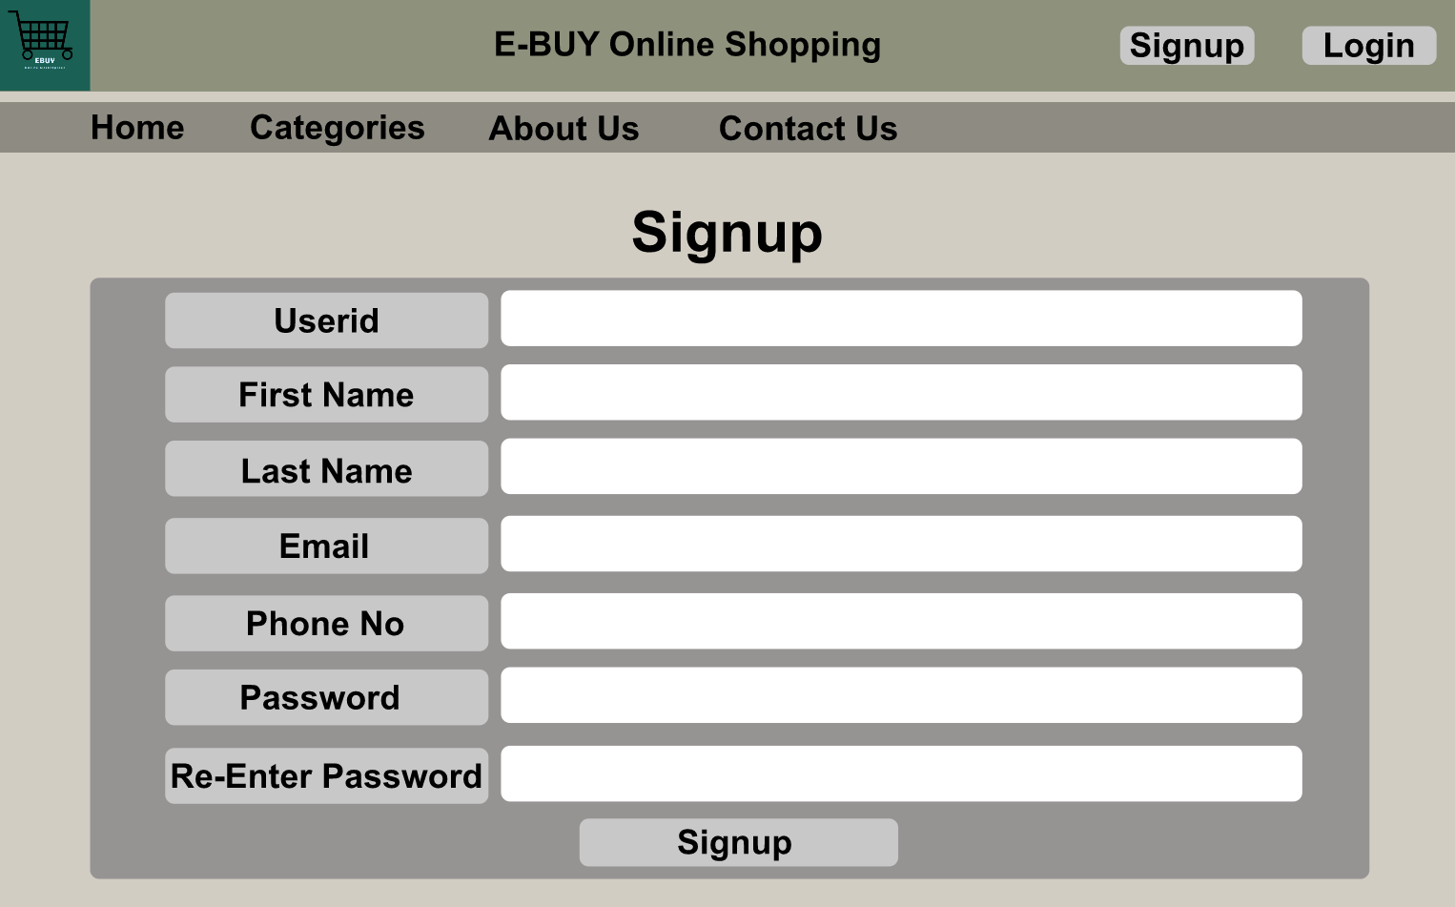
Signup Page

Slide 12
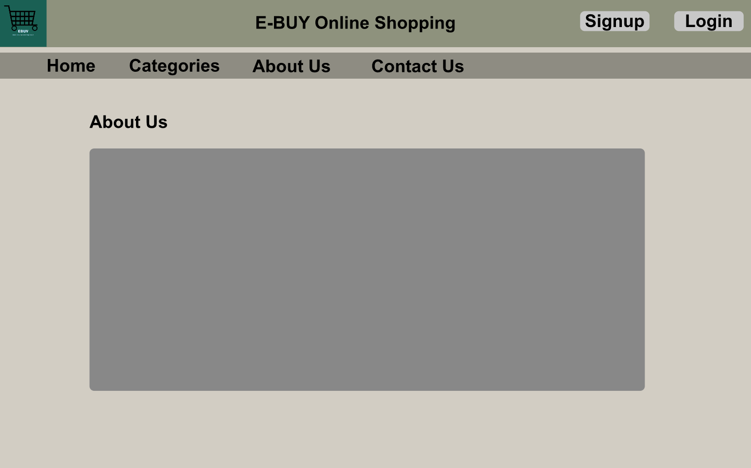
About Us Page

Slide 13
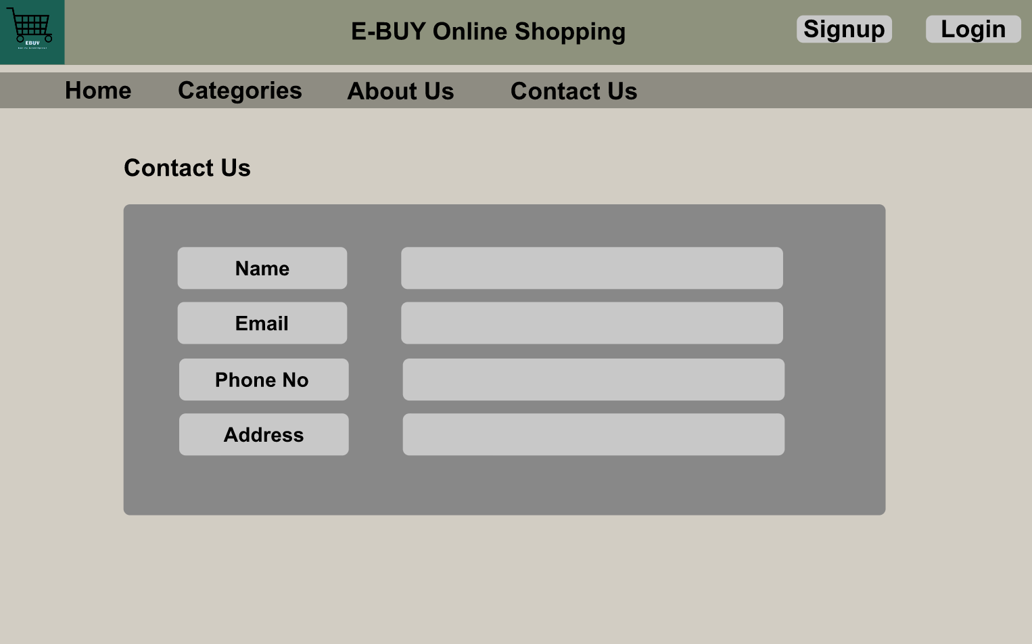
Contact Us Page

Slide 14
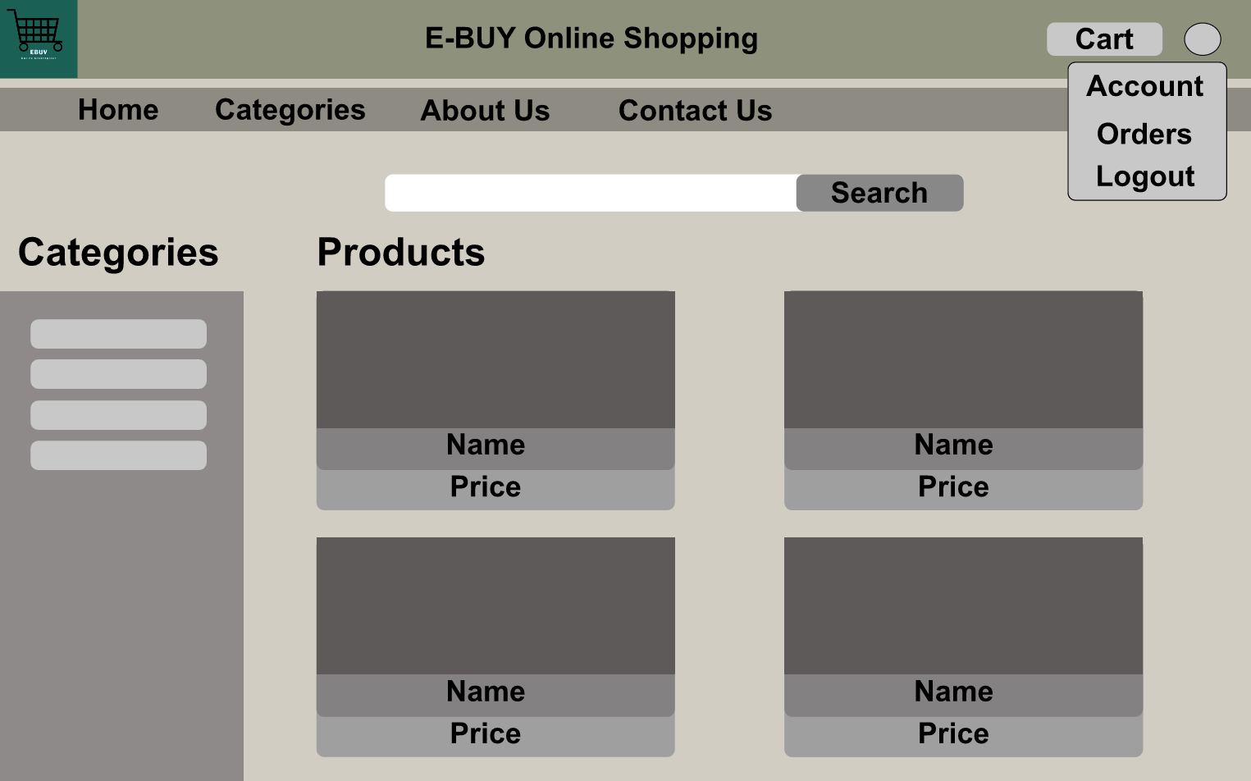
Product Page

Slide 15
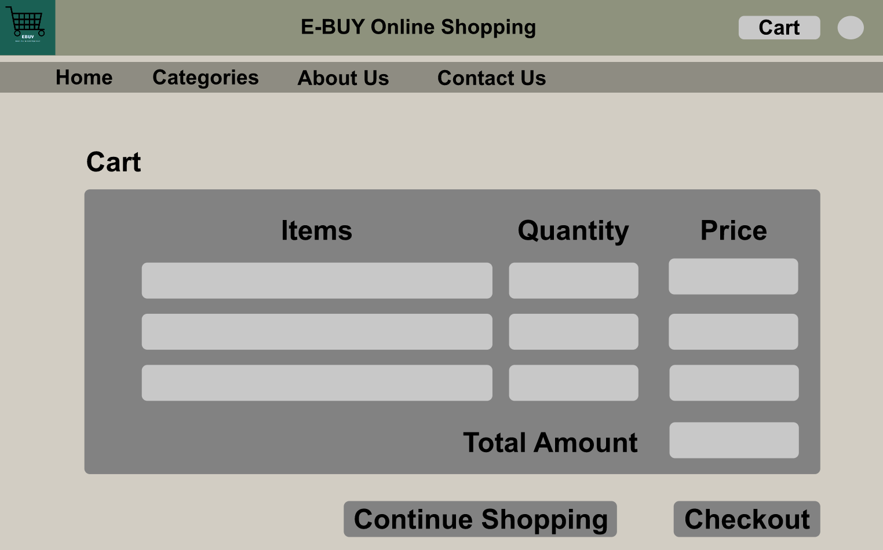
Cart Page

Slide 16
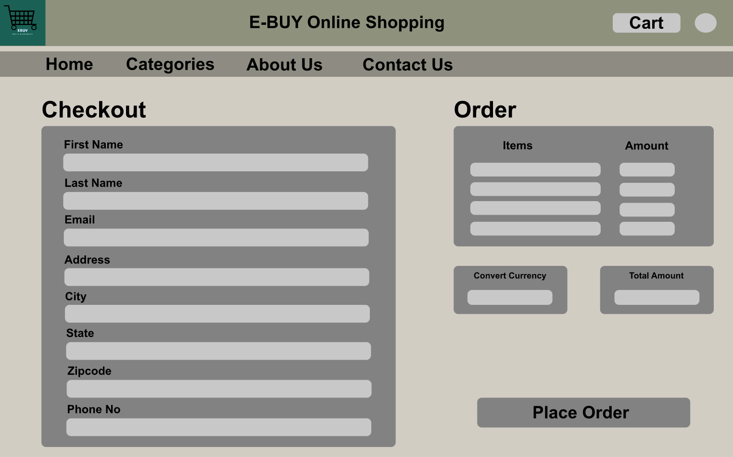
Checkout Page

Slide 17
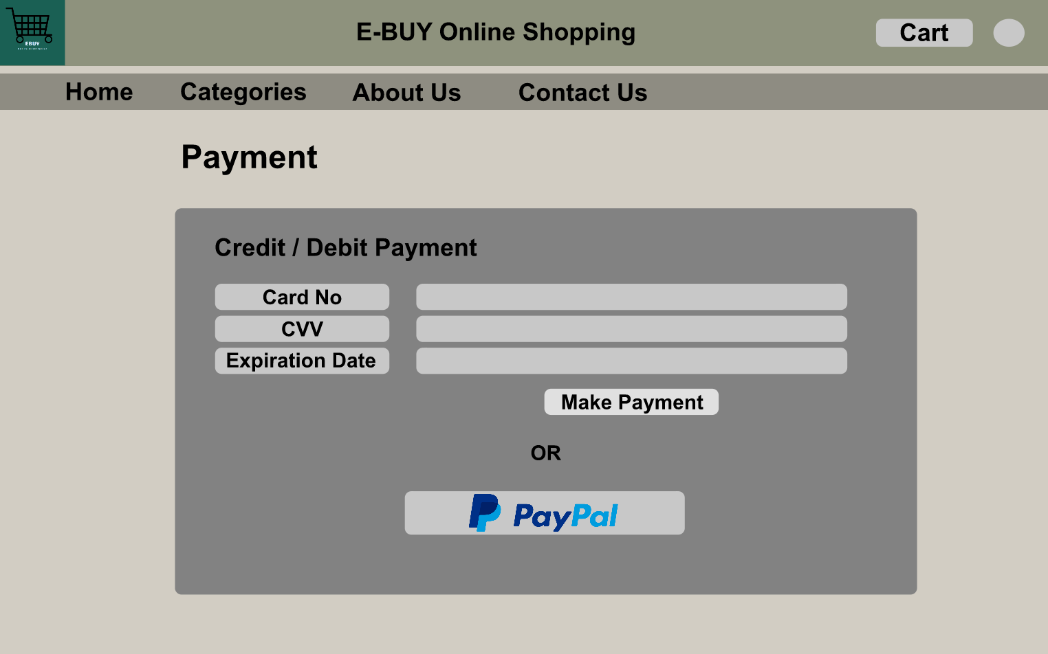
Payment Page

Slide 18
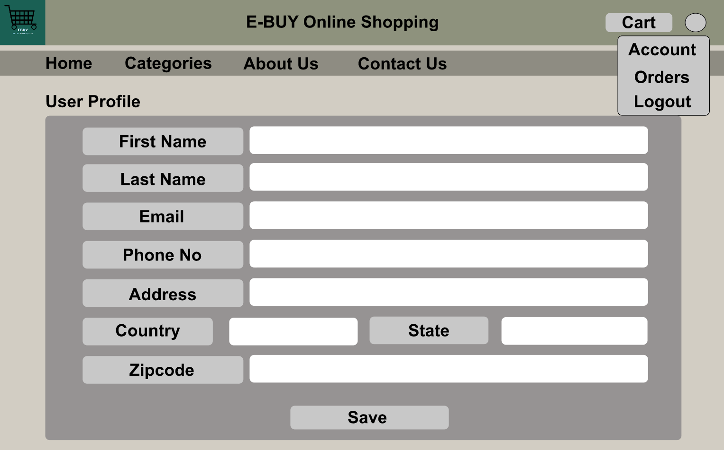
User Profile Page

Slide 19
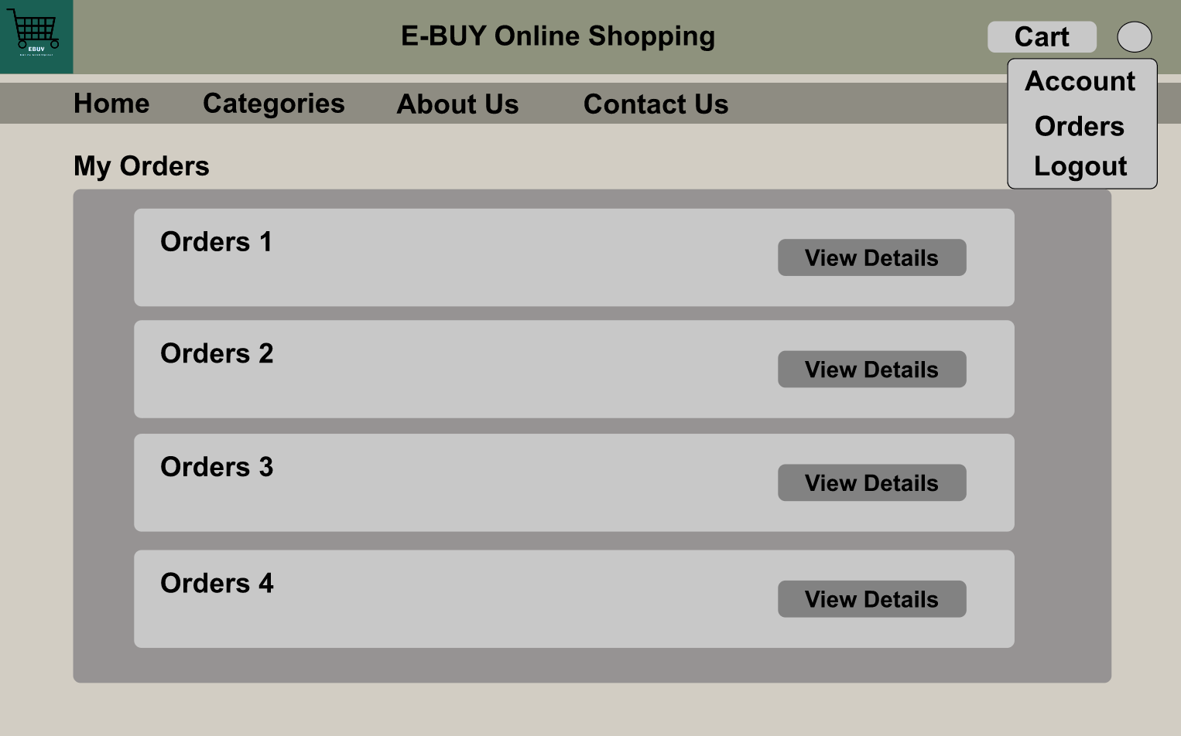
My Orders Page

Slide 20
APIs
Google Sign-in API:
In this Ecommerce application we are going to provide new users to authenticate and sign up for the application by integrating the google sign-in to our application.
https://developers.google.com/identity/sign-in/web/sign-in
Twitter login API:
In this Ecommerce application we are going to provide new users to authenticate and sign up for the application by integrating the twitter login to our application.
https://developer.twitter.com/en/docs/authentication/guides/log-in-with-twitter

Slide 21
APIs
Mailjet:
In this Ecommerce application, we are going to send email notification to the users on the orders that were successfully placed, and the mail would also contain a pdf copy which would contain the order details.
https://dev.mailjet.com/email/guides/
Geo API:
This API will be used for currency conversion for the products in the ecommerce website.
https://getgeoapi.com/documentation/

Slide 22
APIs
PayPal API:
In this ecommerce application, we are going to integrate the PayPal payment gateway for users to make payment for their orders.
https://developer.paypal.com/docs/api/overview/
Twilio API:
This API will be used to send SMS notification and messages to the user on the orders they have places.
https://www.twilio.com/docs/api

Slide 23
Release Plan and Stand-Up notes
Release Plan
https://unomail-my.sharepoint.com/:f:/g/personal/groyce_unomaha_edu/Epczw2bv1N1Eqdk411vD-XcBXJuxdEEvn6T_Tf9wYFCGaA?email=groyce%40unomaha.edu&e=RFegWy
Stand Up notes
https://unomail-my.sharepoint.com/:f:/g/personal/groyce_unomaha_edu/EtoNxhT-hlNLuEfbRLNP1_kBYbtVtfwgVpJrbqJlLzbGiw?email=groyce%40unomaha.edu&e=Jb2TqD

Slide 24
GitHub and Trello Board Links
Project Repo
https://github.com/ISQA-Classes/su2021team2-app.git
Test Repo
https://github.com/ISQA-Classes/su2021team2-test.git
Trello Board
https://trello.com/b/uBOCmf7q/su21team2

Slide 25
Thank You

